Slide 1
User Interfaces for
Embedded Systems
Presentation 8:
HiFi Prototyping

Slide 2
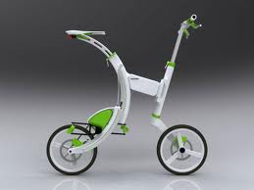
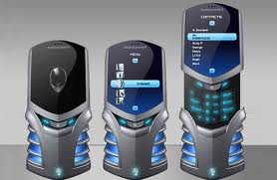
Prototype
Prototype derives from the Greek word prototypon meaning "primitive form", and prototypos, "original, primitive", from protos, meaning "first" and typos, "impression".
Prototyping is the main methodology of ITBFIS

Slide 3

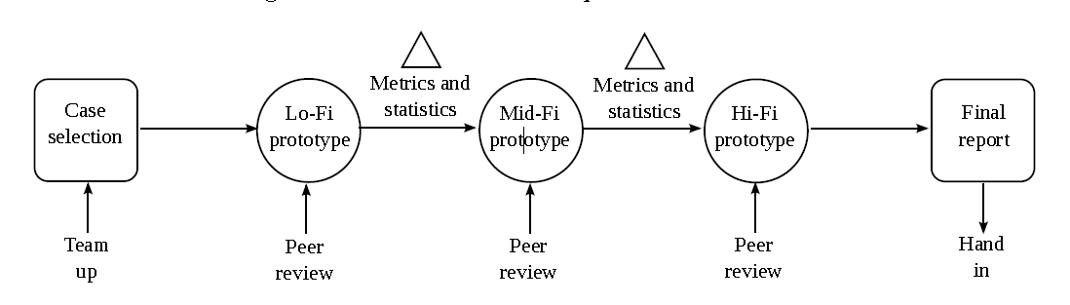
Prototype Driven Development

Slide 4
Advantages of Low-fi Prototyping
Take only a few hours
  No expensive equipment needed
Can test multiple alternatives
  fast iterations
  number of iterations are tied to final quality
Almost all interaction can be faked
Good for participatory design

Slide 5
Problems with Low-fi Prototypes?
Doesn’t map well to what will actual fit on the screen
Realism low - cognitive load high (hard to draw)
Different ergonomics from intended device (touch, speech)
Timing in real-time hard to do
Some things can not be simulated (dragging/highlight)
Lack of interactive feedback (affordances)
Solution: Build more advanced prototypes

Slide 6
RAD Development
Use RAD tools for Rapid Application Development Prototyping
  PowerPoint, Word, HyperCard, Director, HTML-tools
  Eclipse, IntelliJIdea, Visual Studio (widgets) (for evolutionary)
Produces:
  Horizontal / Vertical High-fidelity prototypes = close to real world feel
Test on:
  Real world end-devices, or
  Touch screen computers (or simply PC connected to touch screen)
  Tablet / smart phone
Incremental & Evolutionary
  Danger of ”it’s good enough” effect
  User may sit next to the developer
  Dangerous

Slide 7
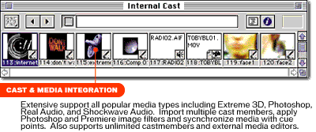
Director Cast
Flash / Shockwave

Slide 8
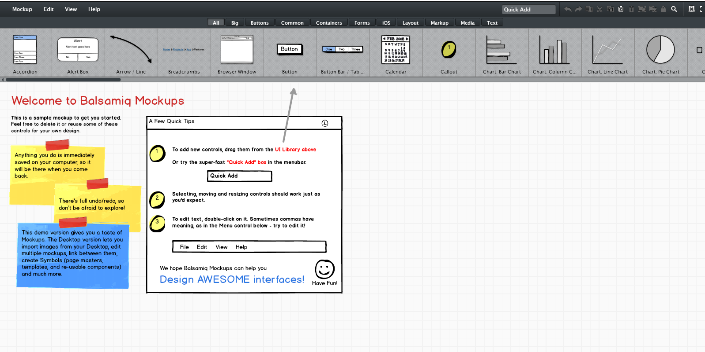
Balsamiq

Slide 9
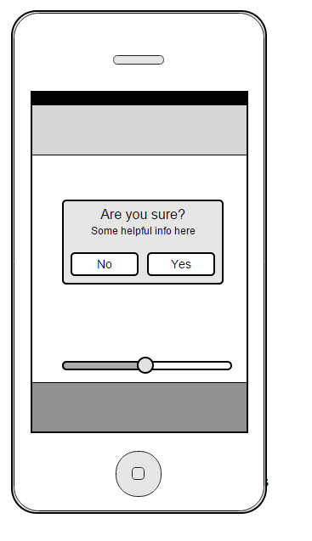
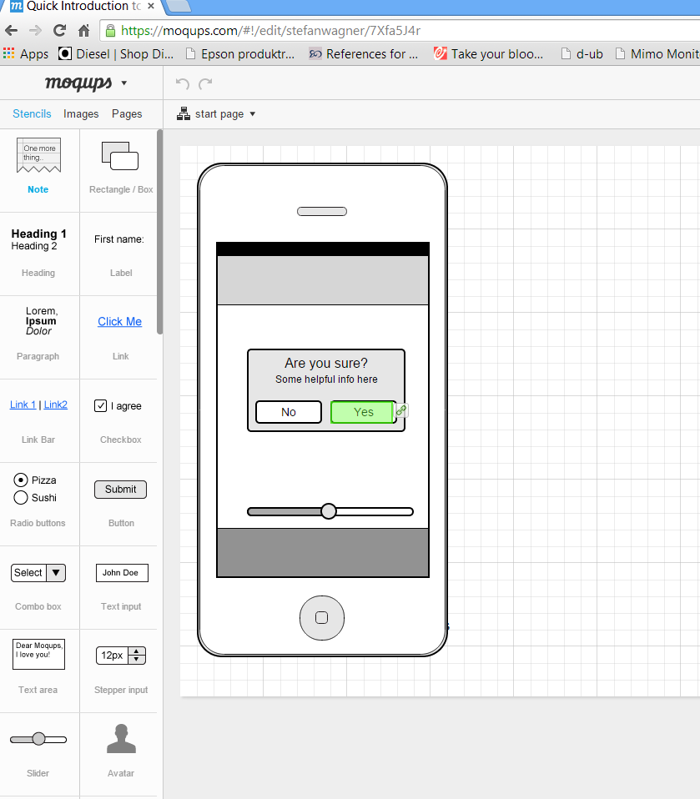
Moqups
https://moqups.com/stefanwagner/7Xfa5J4r/p:a16b2c2a4

Slide 10
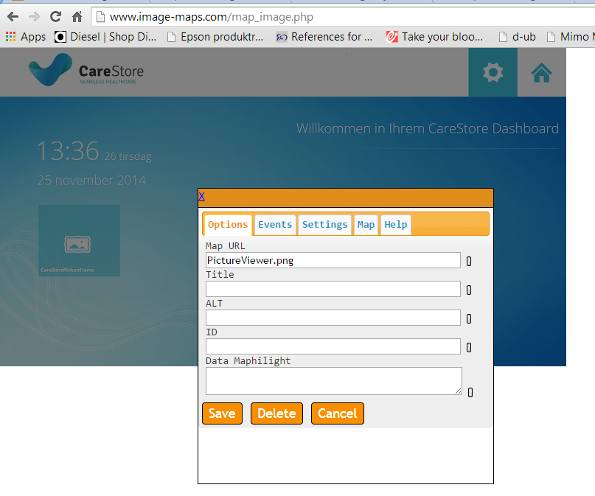
HTML Image Maps
http://www.image-maps.com/

Slide 11
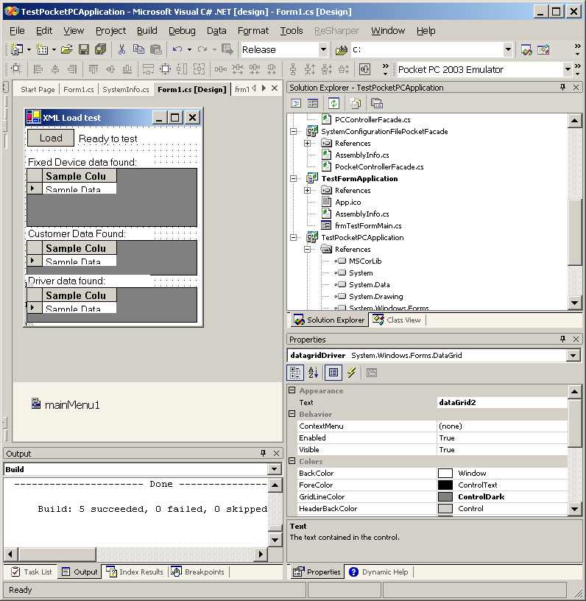
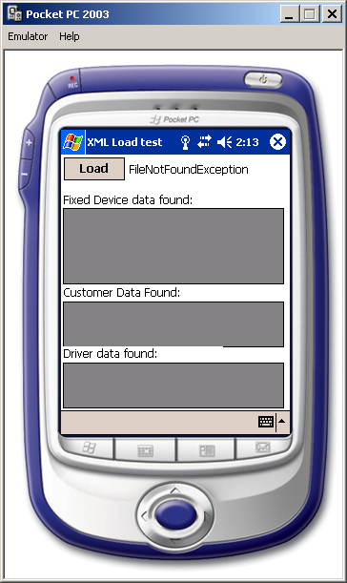
Visual Studio – Windows Phone / Touch

Slide 12
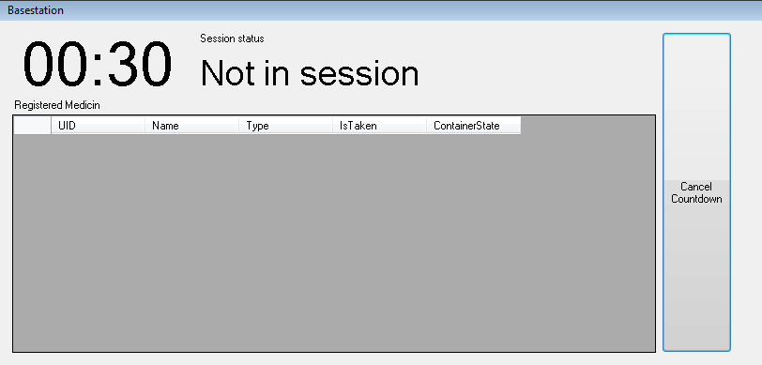
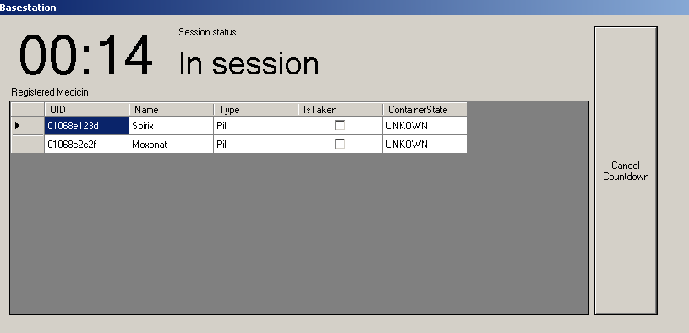
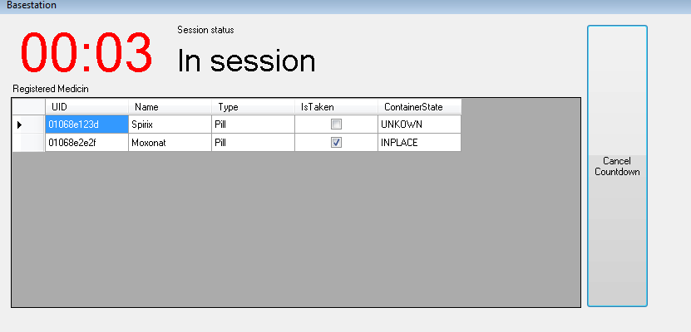
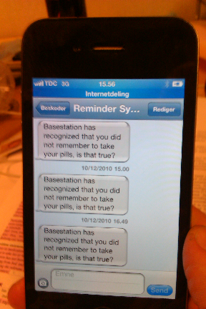
Director or Visual Studio?
Prototyping tools
  Director, Hypercard, PowerPoint
  Use HTML, images, sketches
  Usually higher aesthetics in design
  Produces slower programs
  May evolve to a certain degree – then throw away
IDE tools with UI Builders
  Visual Studio, Eclipse, Delphi
  Uses the standard Widgets available
  May eventually evolve to full product
  May take a longer time to get started with
  Better for developers – not good for designers

Slide 13
Wizard of Oz Technique
The “missing” depth of a high fi prototype
Fake the interaction
  from the film “The Wizard of OZ”
  “the man behind the curtain”
Long tradition in computer industry
  prototypes made of other equipment
Much more important for hard to implement features
  Speech & handwriting recognition
  Definition of HiFi changes depending on the focus

Slide 14
Video prototyping
Good for
  Self evaluation and discussion within research group
  Evaluating complex scenarios
  More realistic wizard of oz prototypes
  Larger user group feedback (group-showings, YouTube)
Easy (use cell phone or cheap video camera)
Possible to edit later
Possible to add relevant information later
May show many different scenarios

Slide 15
Mini Project
Use the Wizard of Oz method to fix the elements you cannot emulate in your HiFi prototypes
Make a Think aloud test combined with the Wizard of Oz
Record this on video and describe your findings in a short document (½ page)
Make two video prototypes of how your two products are supposed to work
Document your findings (½ page)

